Slide 1
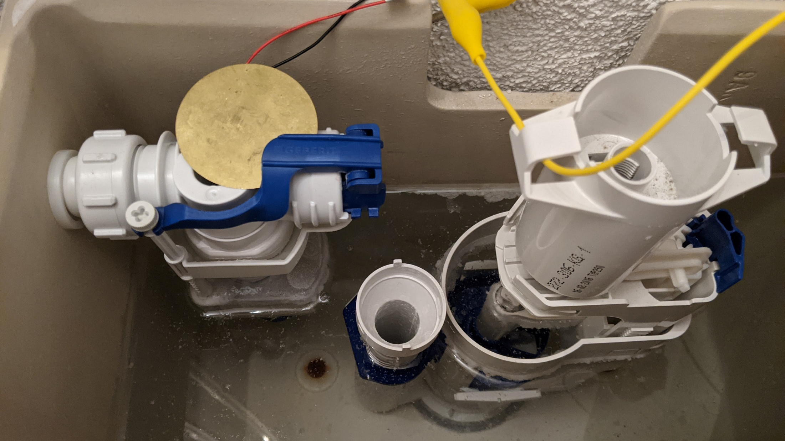
Water saving and leakage Protection System Semesterproject Group02 - HS2020 Bosshard Nico, calovic Aleksandar, Kozlov Victor, Stofer Stephan

Slide 2

AGENDA
Introduction
Integrated Circuits
Sensors
ESP32
Server
Frontend

Slide 3
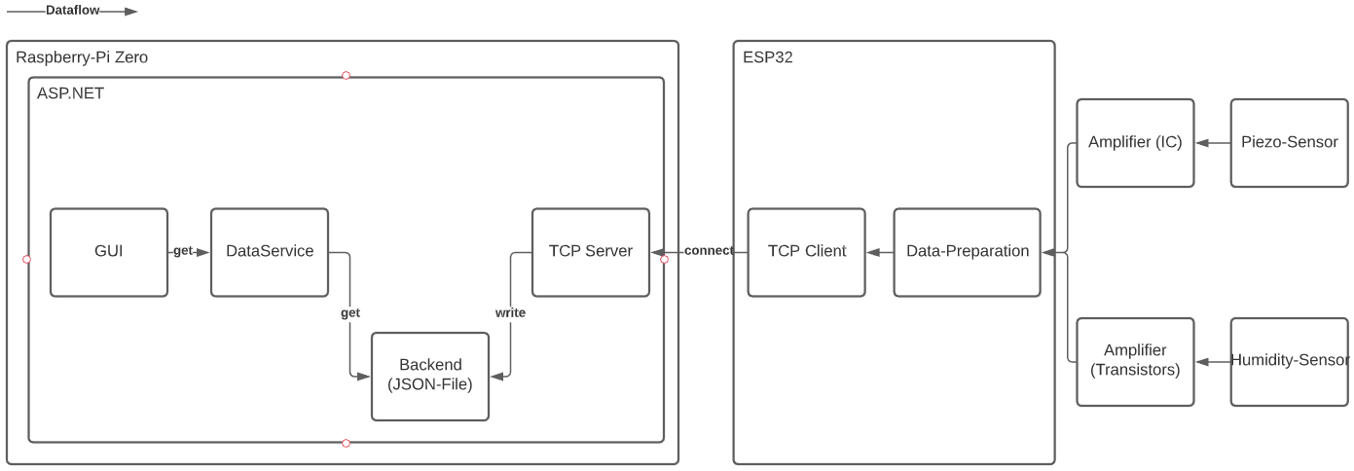
IntroDUction

Slide 4
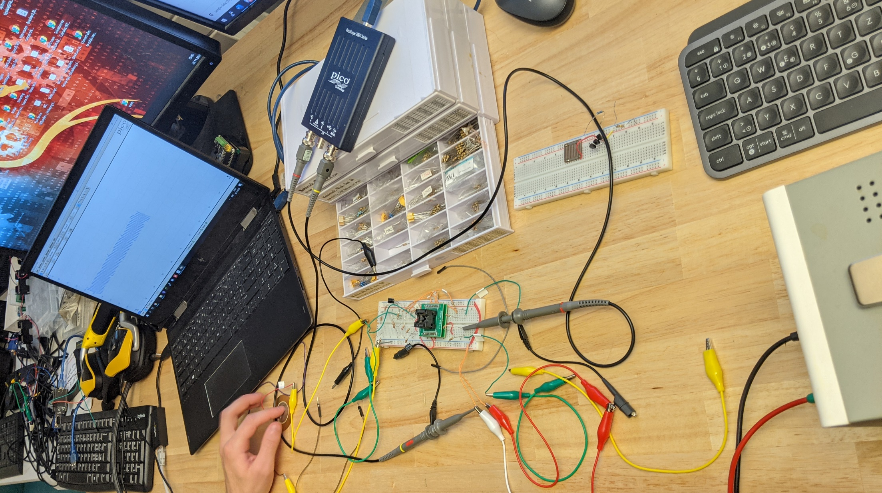
Notes:
00:20

Slide 5

Notes:
00:40

Slide 6
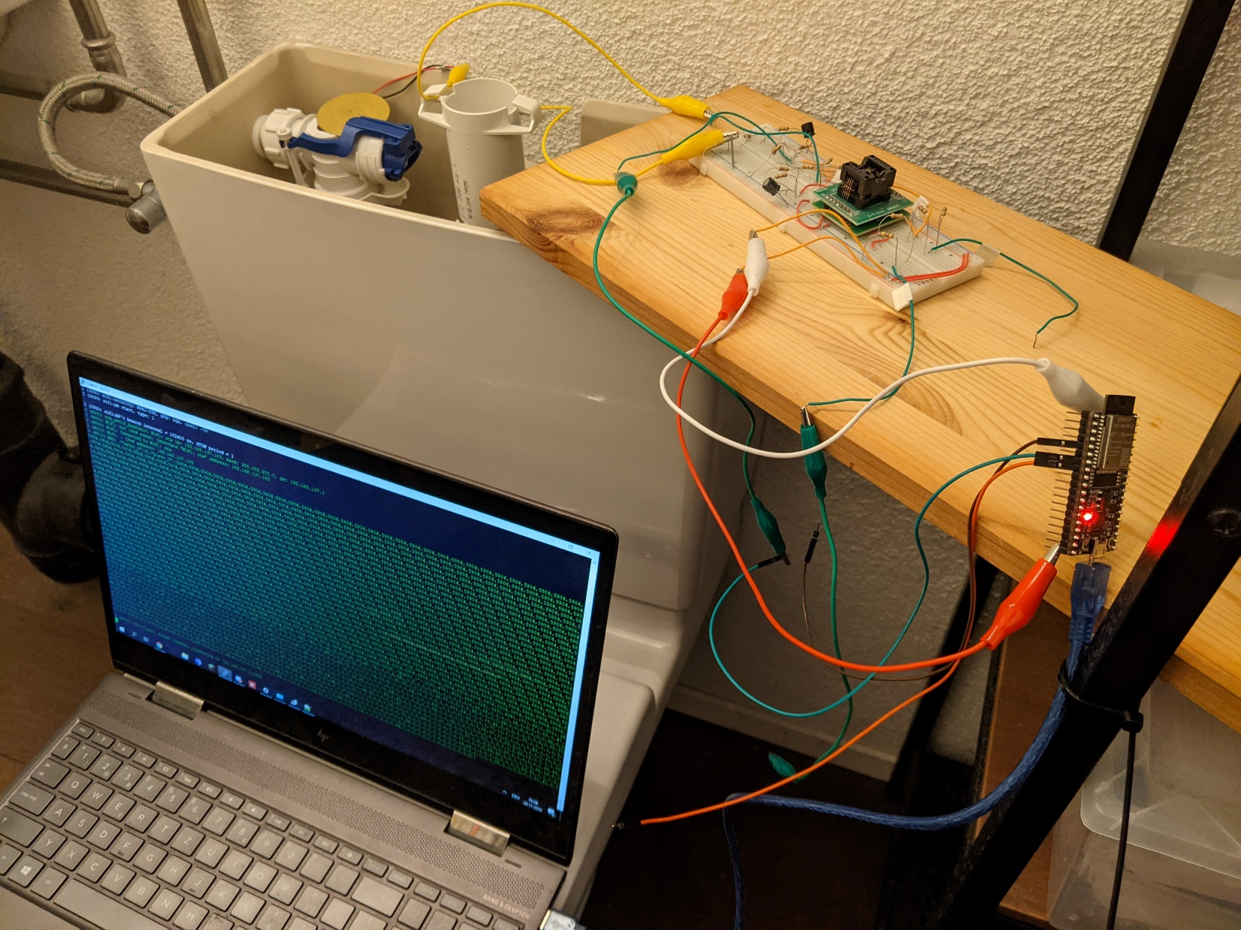
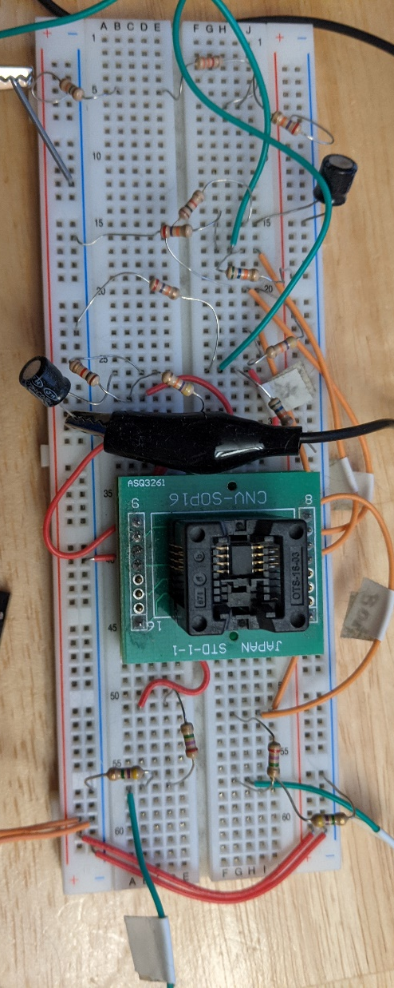
Notes:
1:10

Slide 7
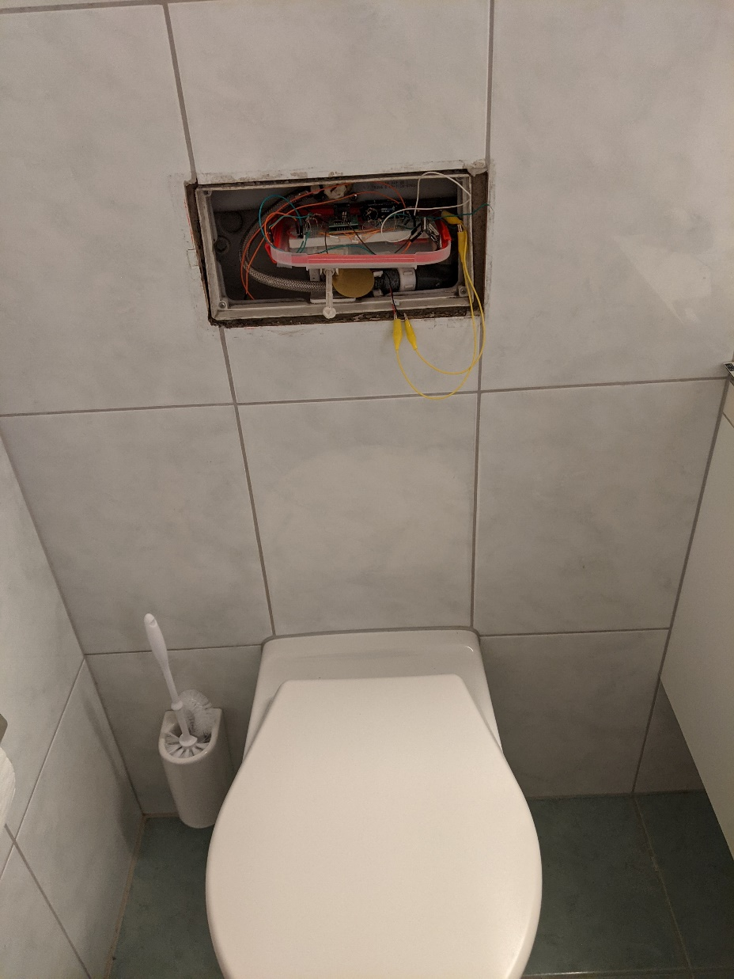
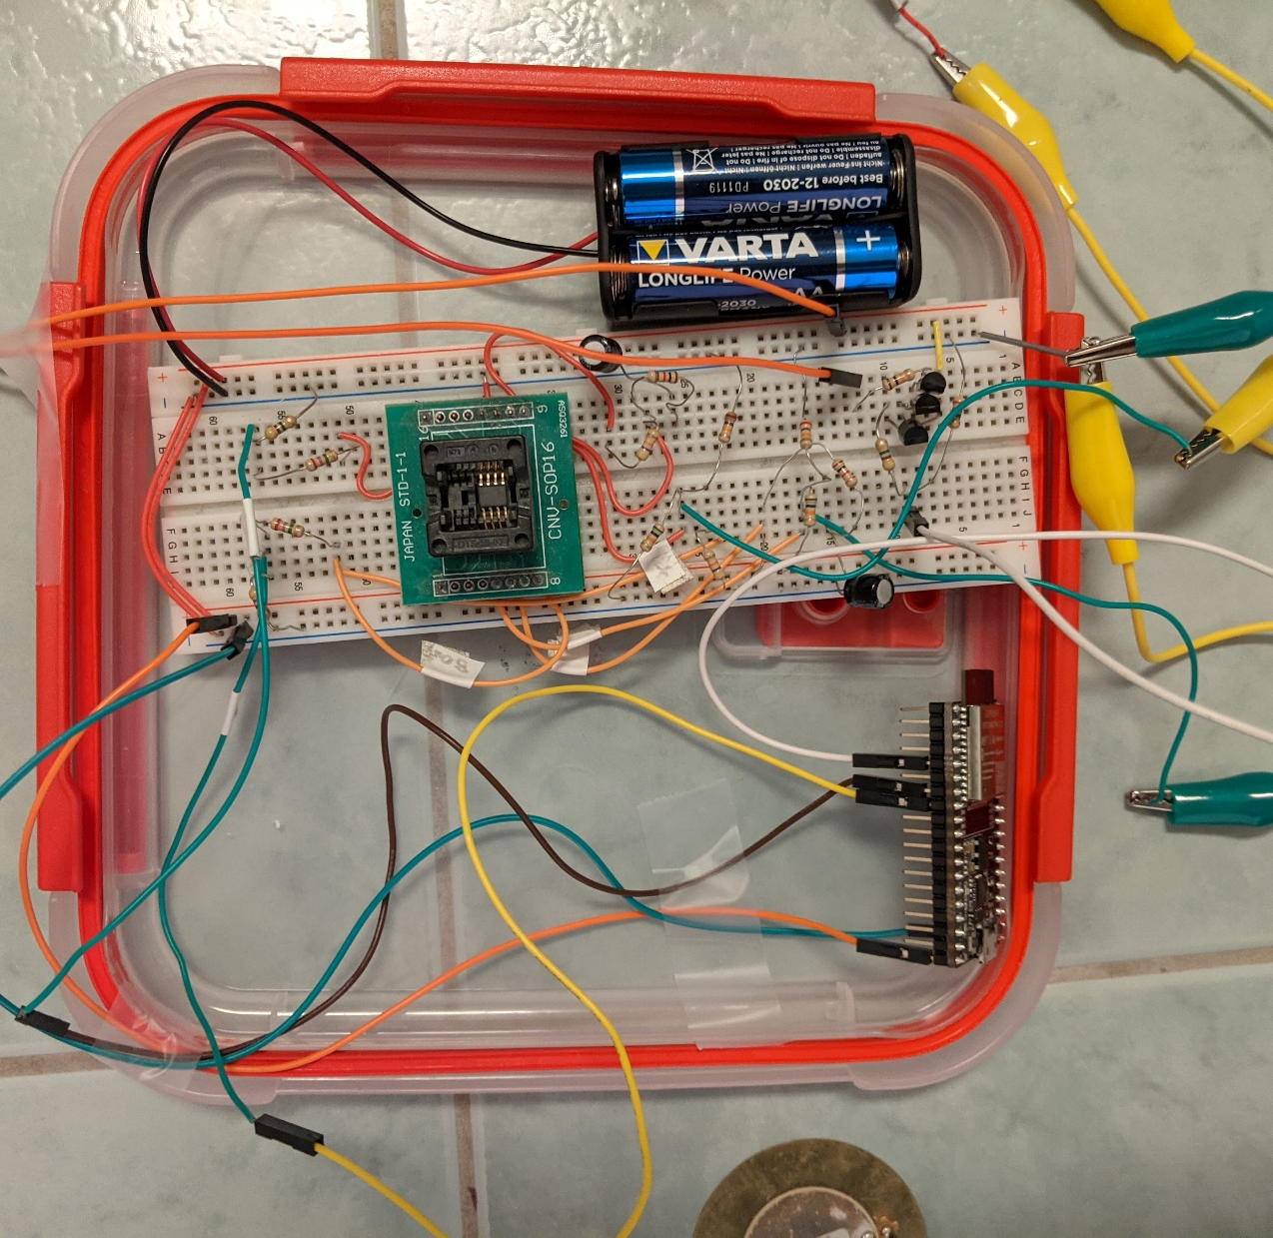
Notes:
1:30

Slide 8
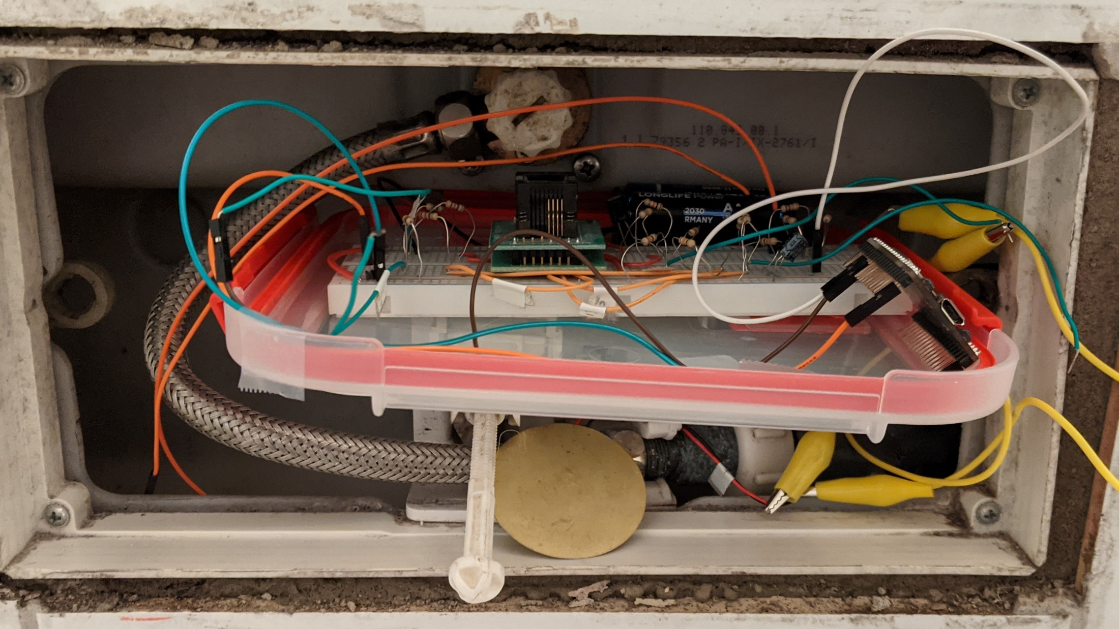
Notes:
1:50

Slide 9
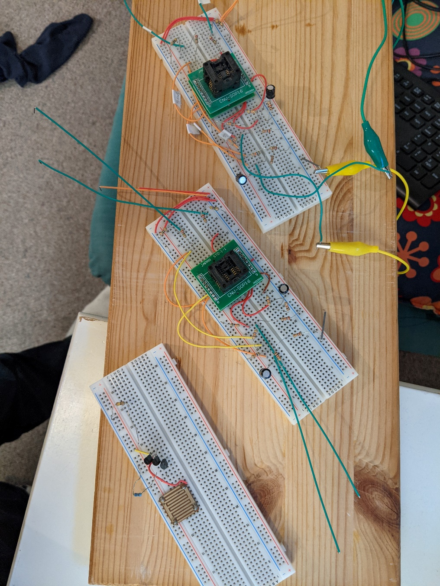
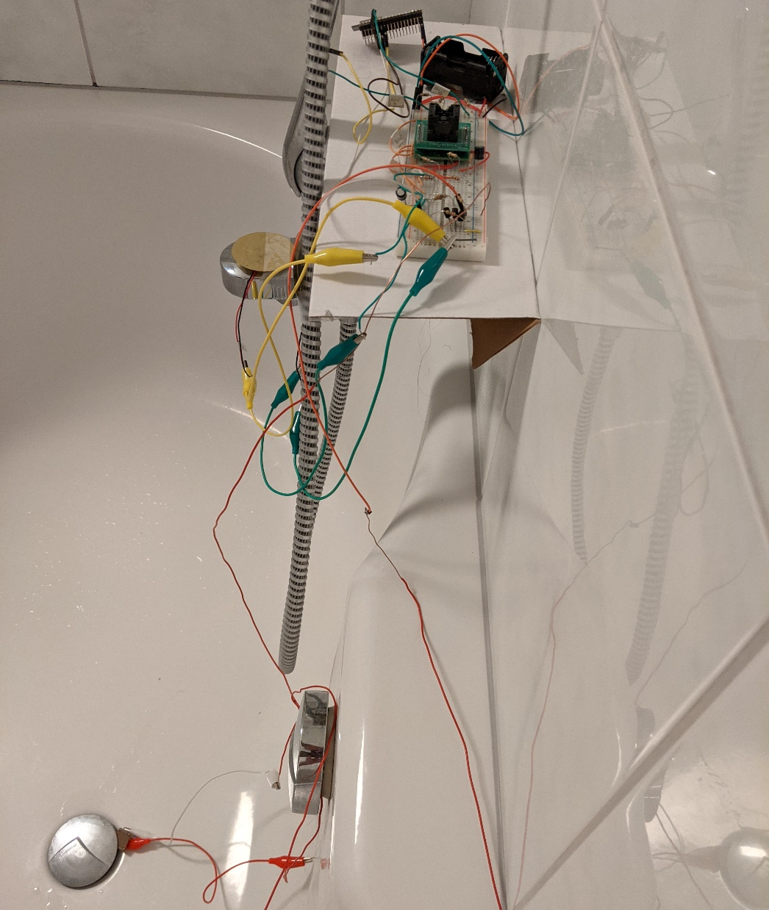
Notes:
2:20

Slide 10
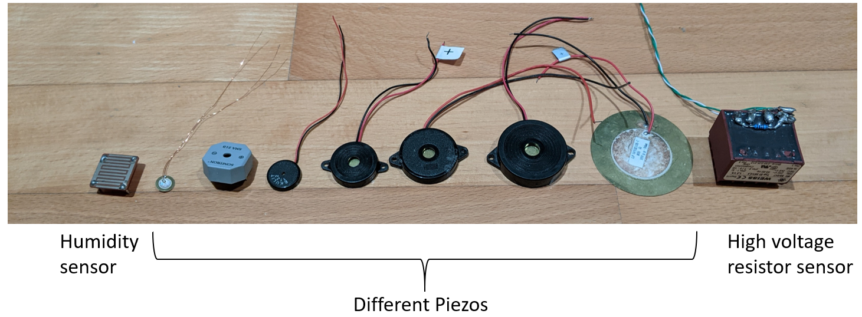
Sensors
Notes:
2:50

Slide 11
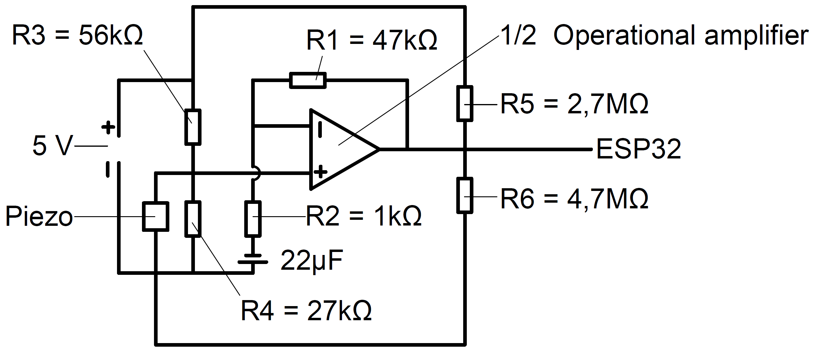
Circuit
Notes:
3:30

Slide 12
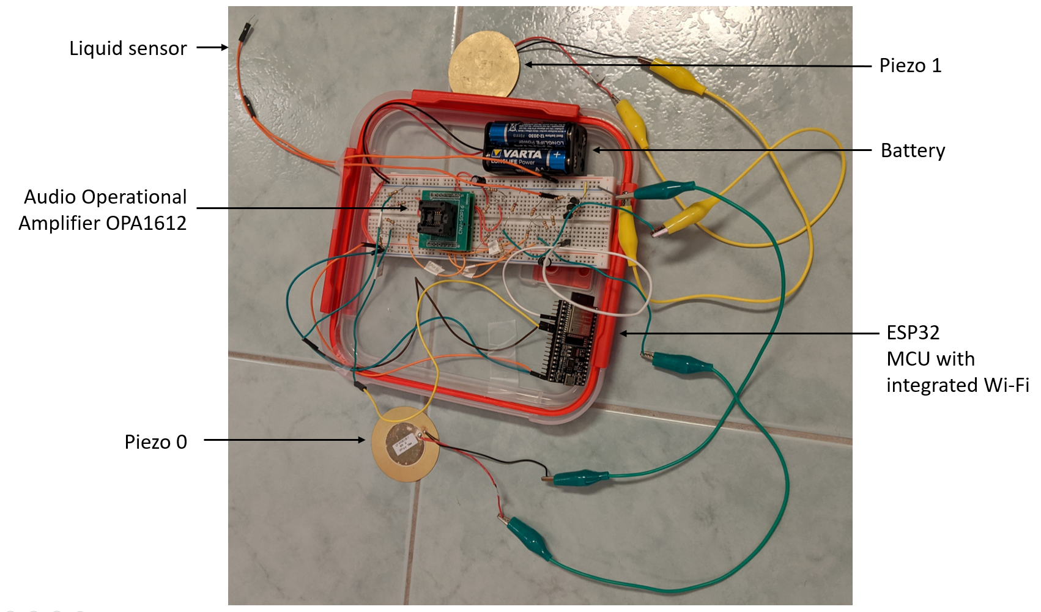
Notes:
4:00

Slide 13
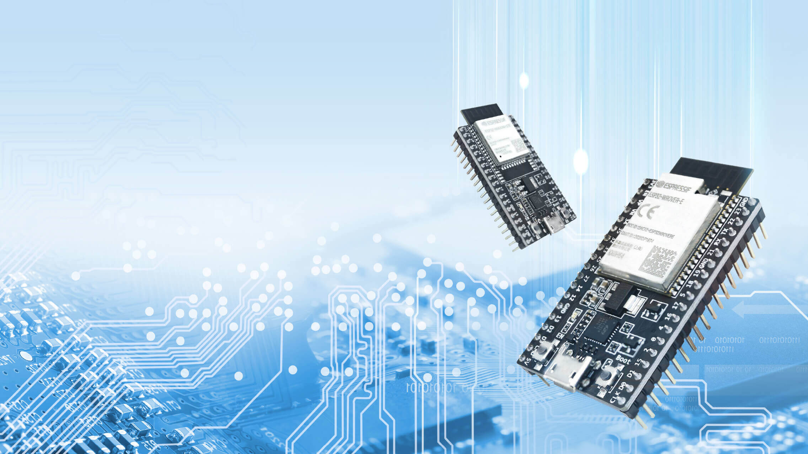
Espressif ESP32

Slide 14
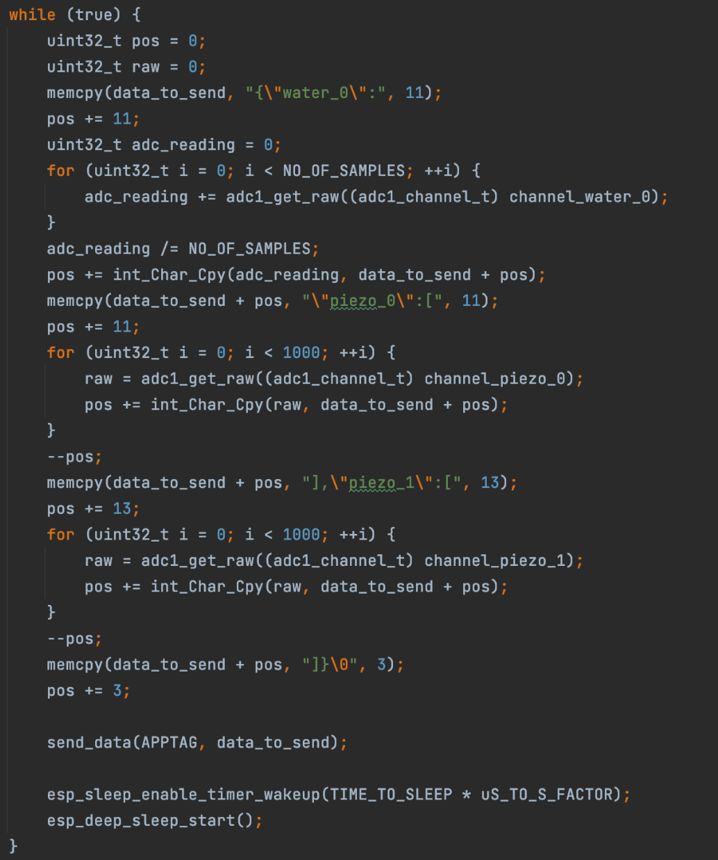
ESP32 Application
Consists of 3 Basis Modules
ADC Reader measure sensors
WiFi connector establish connection to an Access Point
TCP-Client transmits data through TCP Sockets

Slide 15
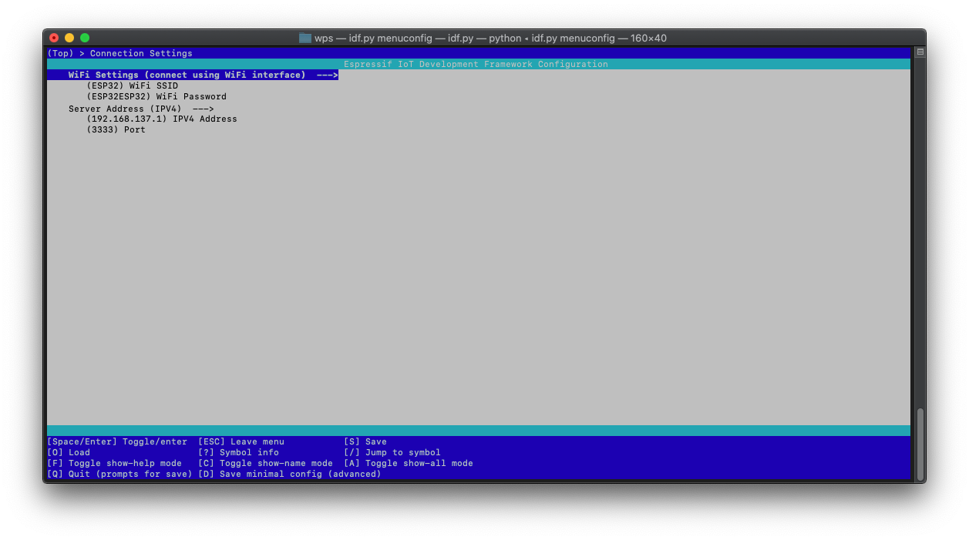
ESP32 Config
WiFi Settings
Server Address

Slide 16
Backend Server
Implemented in .NET Core
Receives TCP packages from ESP32
Sends email if threshold is exceeded

Slide 17
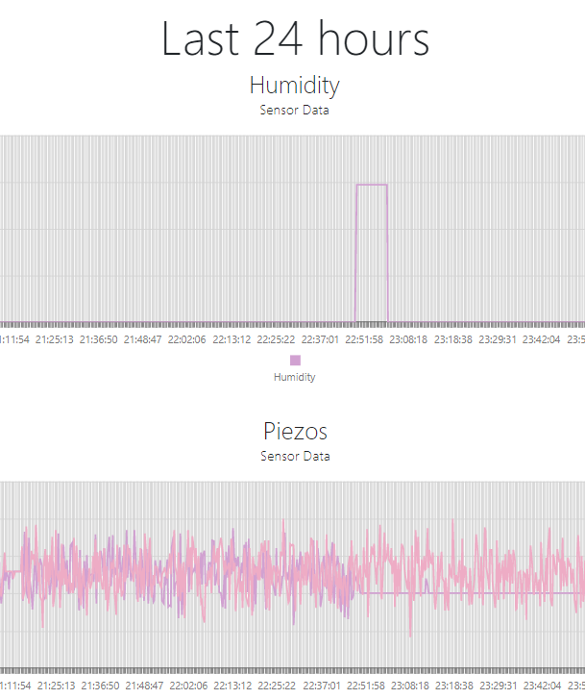
Frontend
Shows whole measurement history and last 24h history in a chart
Implemented in ASP.NET Core
Hosted on Raspberry Pi 0 W
Buildable for all plattforms (inclusive Linux)

Slide 18
Demonstration
Thank you for your attention
Group02, HS2020

